Slide 1


GBME Probability and Statistics | Fall 2018
Lecture 04 | 091218
Lecture 04
Comparing distributions, Normal model
CHOONG-WAN WOO | COCOAN lab | http://cocoanlab.github.io

Slide 2
Lecture 04 | 091218
Key Points
Chapter 3: Displaying categorical data
Bar chart for categorical data
Pie chart for proportions of whole
Faithful reporting and the area principle
Contingency tables
Simpson’s paradox
Chapter 4: Displaying quantitative data
Histograms, Stem-leaf, dot plots
Shape (mode, symmetrical)
Center (median, mean)
Spread (range, IQR, variance, standard deviation)
Box plots
CHOONG-WAN WOO | COCOAN lab | http://cocoanlab.github.io

Slide 3
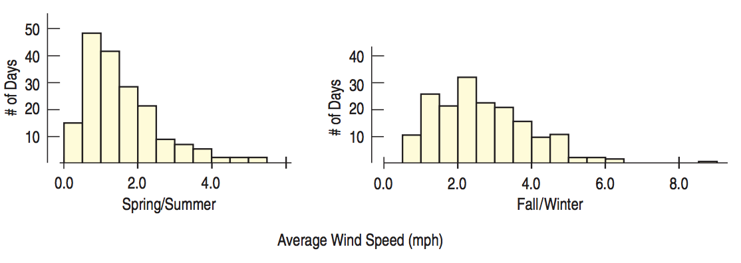
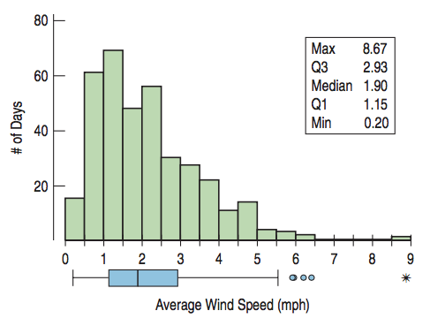
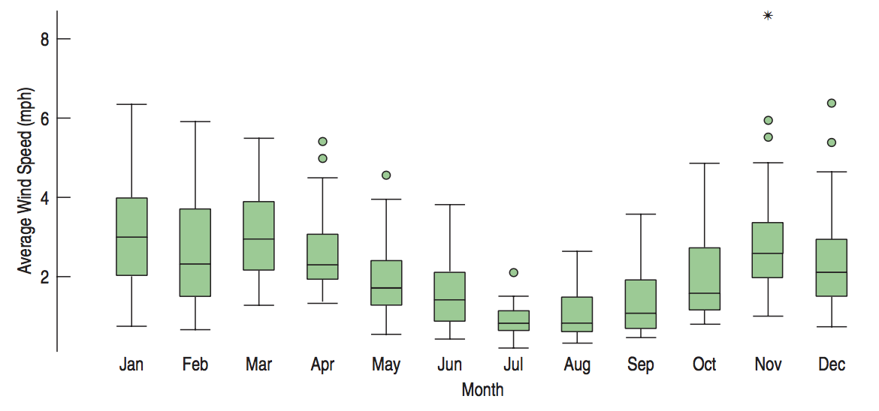
Lecture 04 | 091218
Comparing Groups with Histogram and Boxplots
Data:
Who: Days during 2011
When: 2011
What: Average daily wind speed (mph)
Where: Hopkins Forest in western Massachusetts
Why: Long-term observations to study ecology and climate
Outliers are context dependent!
CHOONG-WAN WOO | COCOAN lab | http://cocoanlab.github.io

Slide 4
Lecture 04 | 091218
Outliers
Outliers may be the most important values.
Or they maybe just errors.
What to do with them?
Correct them if possible
Report summaries and analyses with and without the outliers (readers can decide)
Some statistical methods: down-weight them (e.g., robust regression), smoothing, etc.
Never do:
Leave them in place and proceed as if nothing were unusual
Omit an outlier from the analysis without comment
CHOONG-WAN WOO | COCOAN lab | http://cocoanlab.github.io

Slide 5
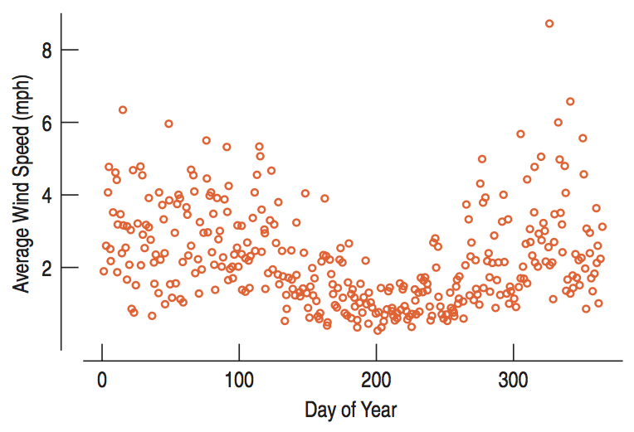
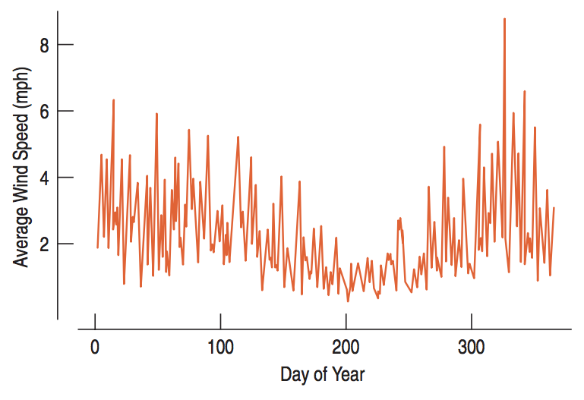
Lecture 04 | 091218
Timeplots
Values against time: timeplot, time-series data (e.g., neural activity data, stock market, bio-sensor…)
CHOONG-WAN WOO | COCOAN lab | http://cocoanlab.github.io

Slide 6
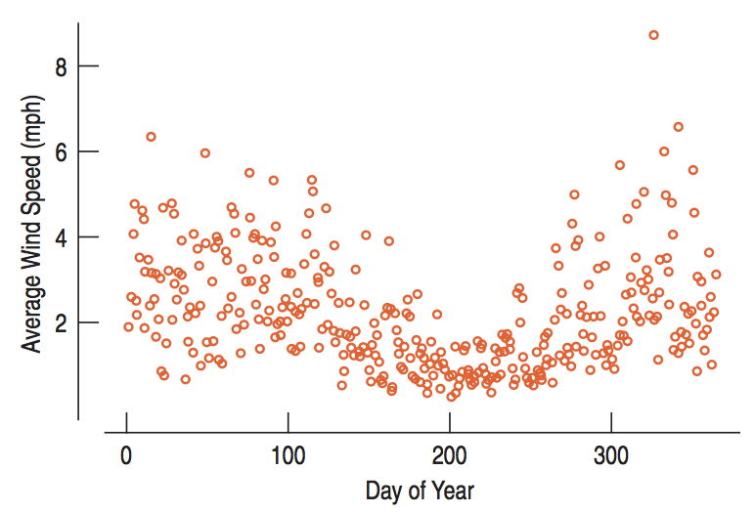
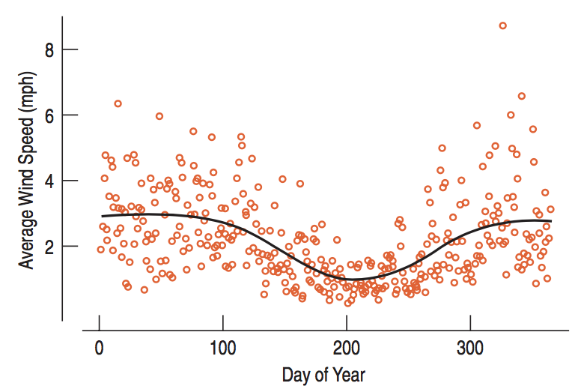
Lecture 04 | 091218
Smoothing timeplots
Lowess (locally weighted scatterplot smoothing)
Moving average
CHOONG-WAN WOO | COCOAN lab | http://cocoanlab.github.io

Slide 7
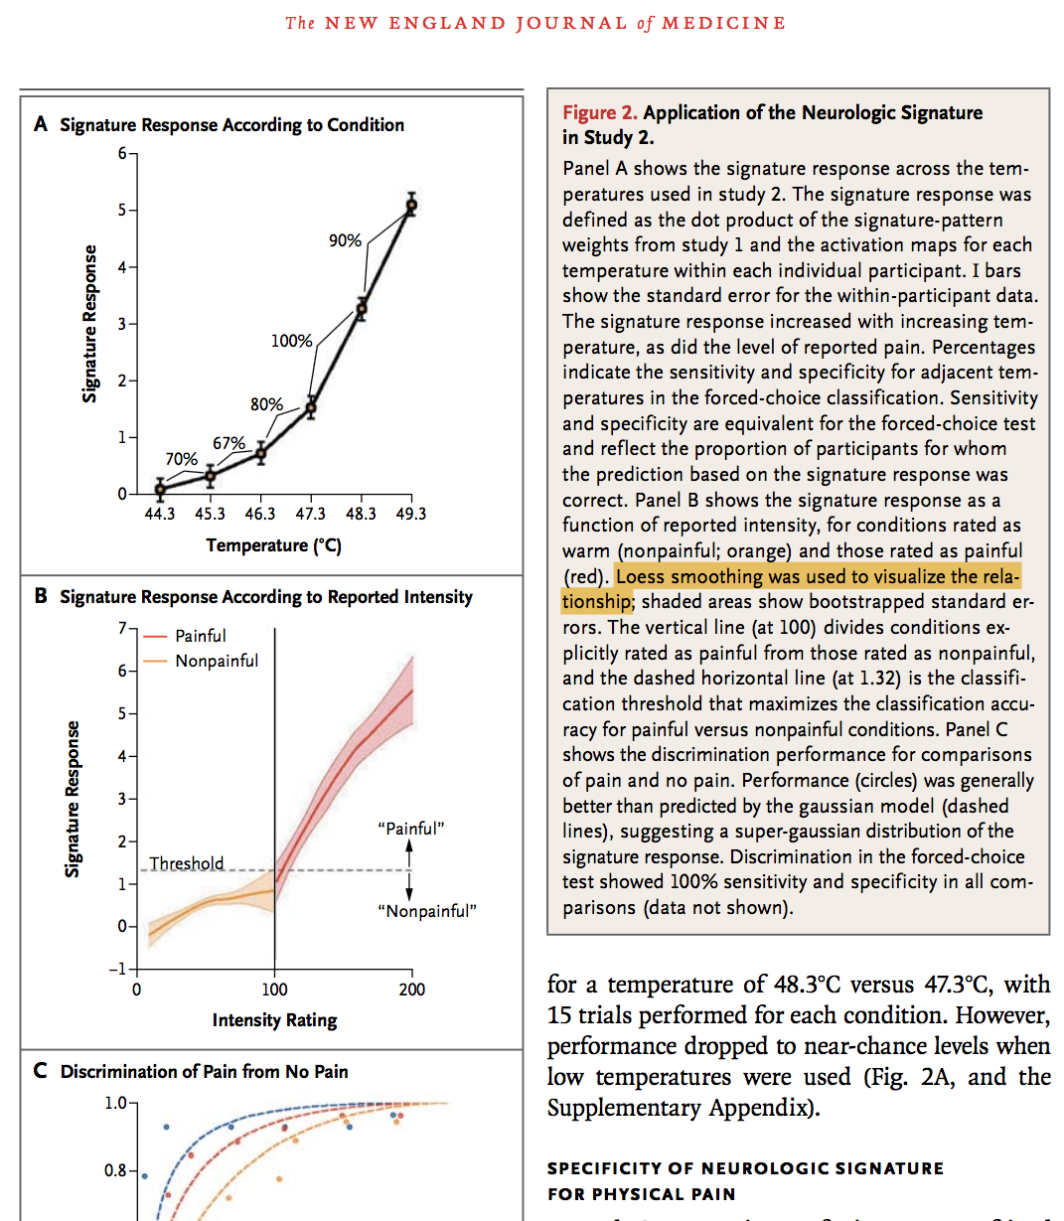
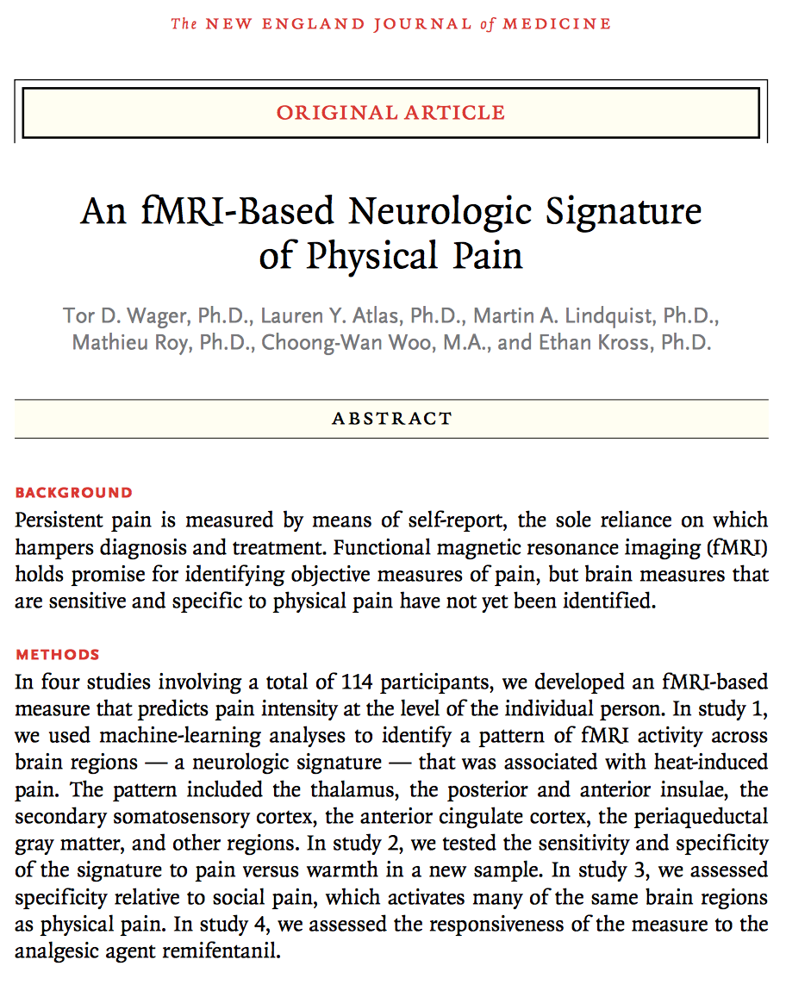
Lecture 04 | 091218
Smoothing timeplots
Lowess (locally weighted scatterplot smoothing)
CHOONG-WAN WOO | COCOAN lab | http://cocoanlab.github.io

Slide 8
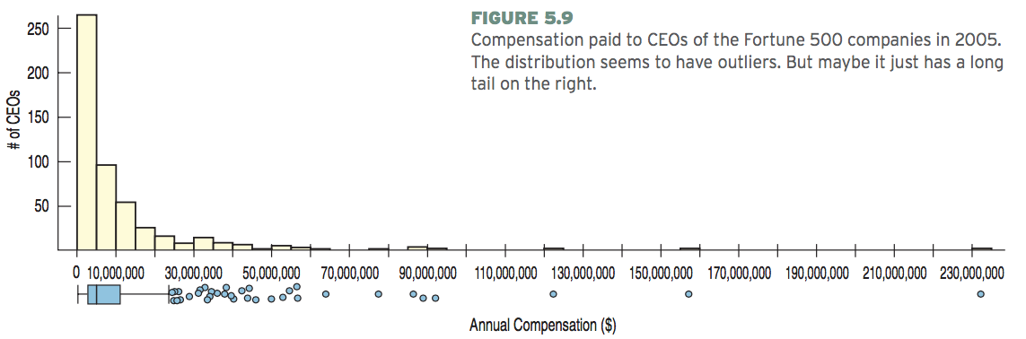
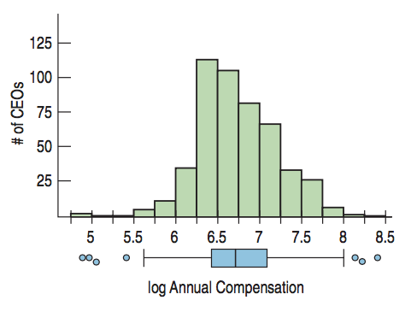
Lecture 04 | 091218
Re-expressing Data
To improve symmetry:
Logarithms of 2005 CEO compensations
Very common in physio data preprocessing
E.g., logarithm, square root (normalization)
CHOONG-WAN WOO | COCOAN lab | http://cocoanlab.github.io

Slide 9
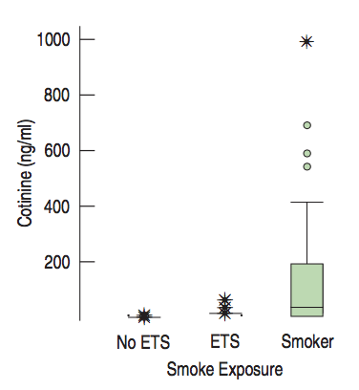
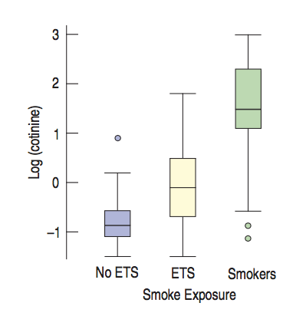
Lecture 04 | 091218
Re-expressing Data
To equalize spread across groups
Log-transform
*ETS: exposed to smoke
Normalization is one of the key elements for recent successes of artificial intelligence (machine learning)
CHOONG-WAN WOO | COCOAN lab | http://cocoanlab.github.io

Slide 10
Lecture 04 | 091218
Key Points
Chapter 5: Comparing distributions
Outliers are context dependent
Timeplots
Moving-averages, smoothing
Re-expressing data (log, sqrt)
to improve symmetry
to equalize spread
CHOONG-WAN WOO | COCOAN lab | http://cocoanlab.github.io

Slide 11
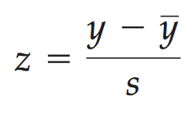
Lecture 04 | 091218
z-Scores
To compare different values in different units,
the values should be standardized!
standardized values
z-scores
= using standard deviation as a ruler!
Two elements: shifting and scaling
CHOONG-WAN WOO | COCOAN lab | http://cocoanlab.github.io

Slide 12
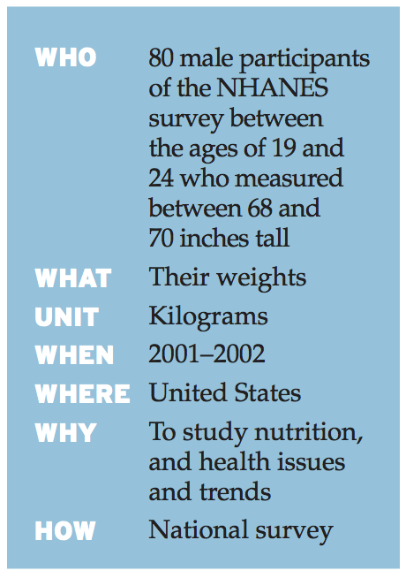
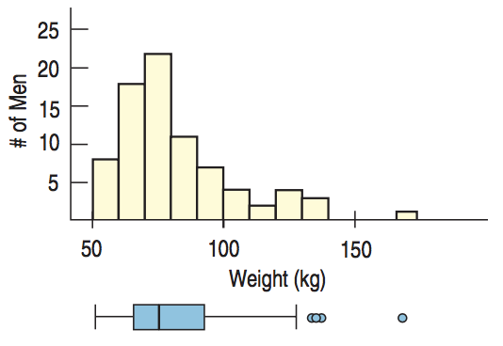
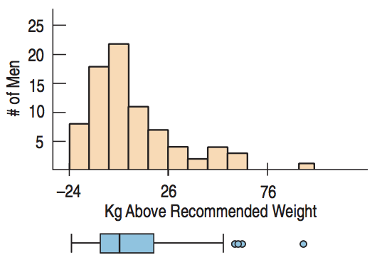
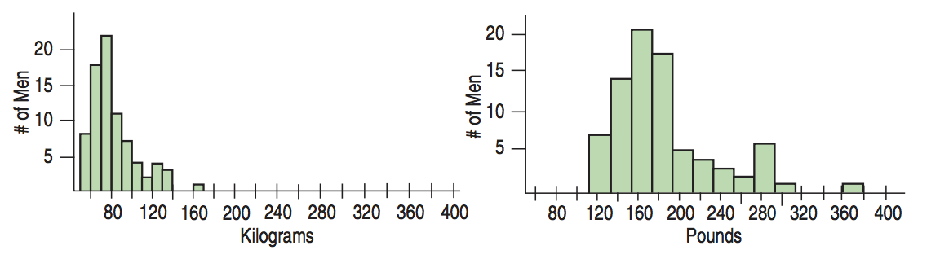
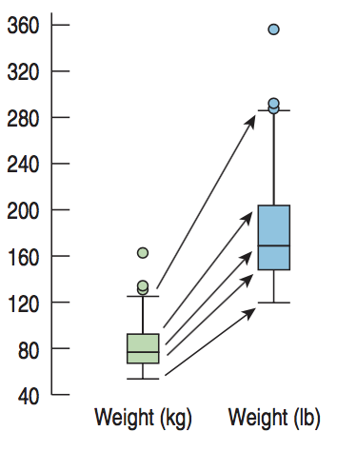
Lecture 04 | 091218
Shifting and rescaling
Subtract recommended weight: 74 kg
CHOONG-WAN WOO | COCOAN lab | http://cocoanlab.github.io

Slide 13
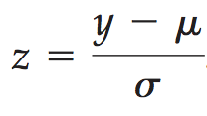
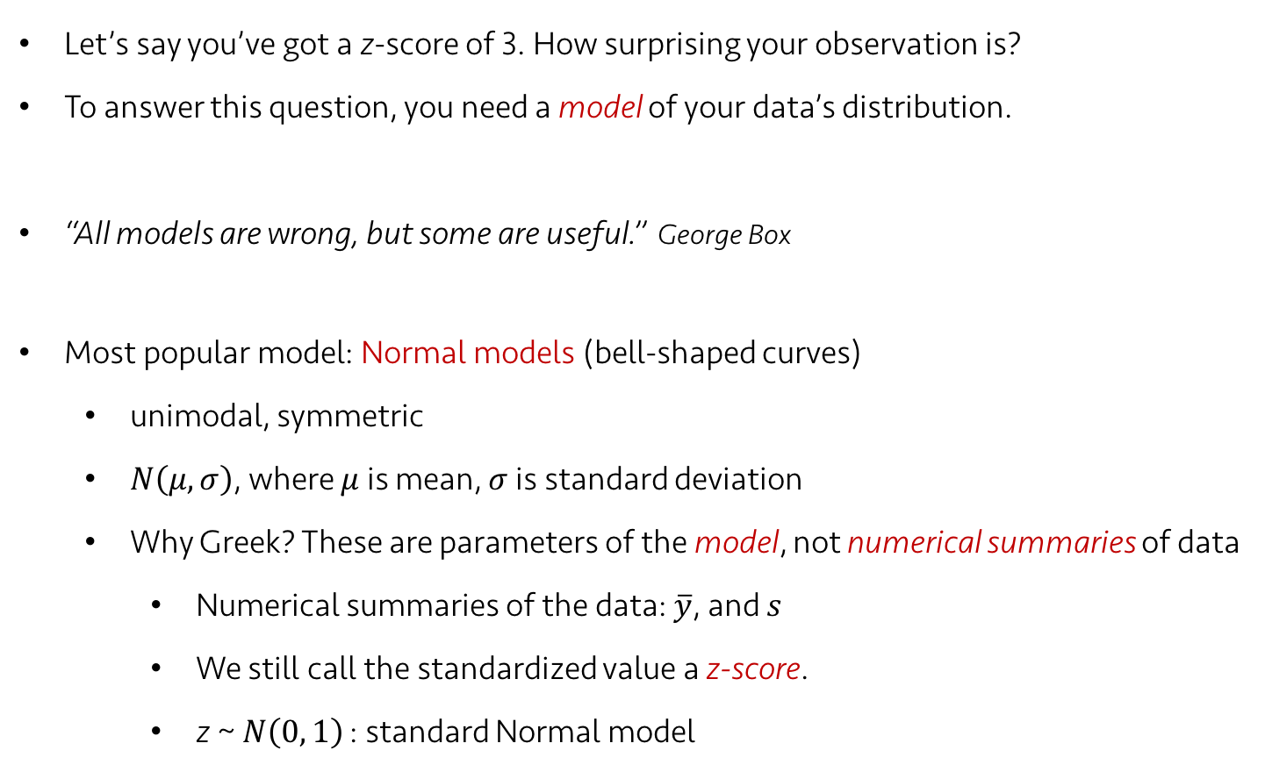
Lecture 04 | 091218
Normal models: When is a z-score big?
Let’s say you’ve got a z-score of 3. How surprising your observation is?
To answer this question, you need a model of your data’s distribution.
“All models are wrong, but some are useful.” George Box
Most popular model: Normal models (bell-shaped curves)
unimodal, symmetric
$N\left(μ, σ\right)$, where $μ$ is mean, $σ$ is standard deviation
Why Greek? These are parameters of the model, not numerical summaries of data
Numerical summaries of the data: $\overline{y}$, and $s$
We still call the standardized value a z-score.
z ~ $N\left(0, 1\right)$ : standard Normal model
CHOONG-WAN WOO | COCOAN lab | http://cocoanlab.github.io

Slide 14
Lecture 04 | 091218
Normality assumption
All models make assumptions, which should be carefully examined.
Nearly normal condition (it’s sufficient):
shape: unimodal, symmetric
We can check it with histogram or a normal probability plot.
and also by checking the associated conditions
CHOONG-WAN WOO | COCOAN lab | http://cocoanlab.github.io

Slide 15
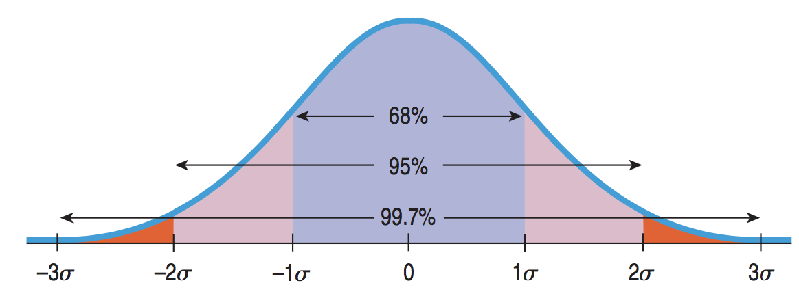
Lecture 04 | 091218
The 68–95–99.7 Rule
68% of the data fall within 1 standard deviation, 95% within 2 std, 99.7% within 3 std.
z-score = 1 means, you are 84%! Why?
100-(50-68/2) = 84%
CHOONG-WAN WOO | COCOAN lab | http://cocoanlab.github.io

Slide 16
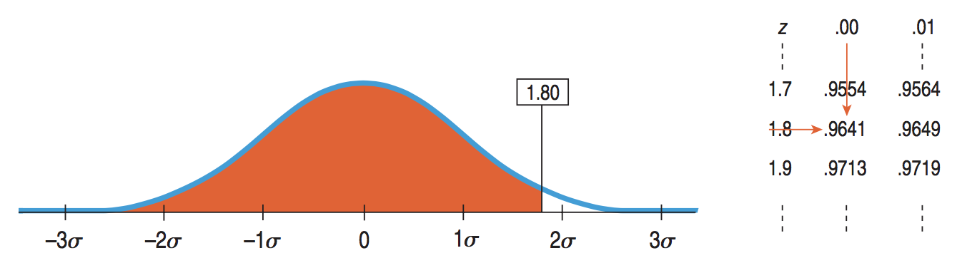
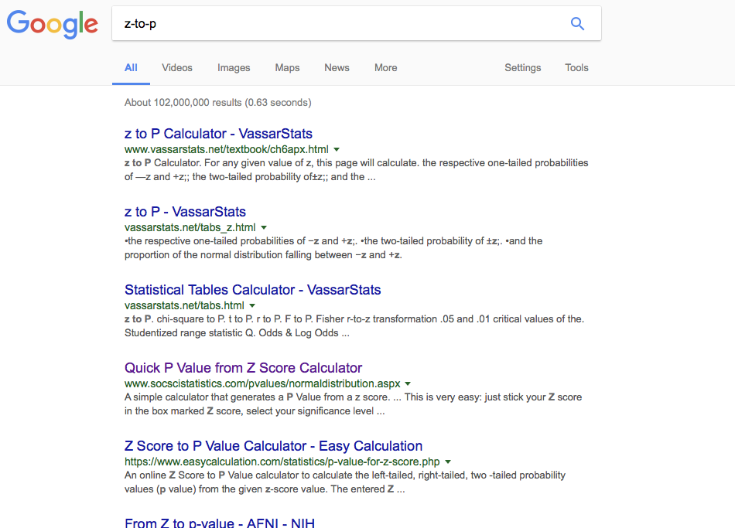
Lecture 04 | 091218
Finding Normal percentiles
A table of Normal percentiles (Table Z in Appendix D)
Or google it!
CHOONG-WAN WOO | COCOAN lab | http://cocoanlab.github.io

Slide 17
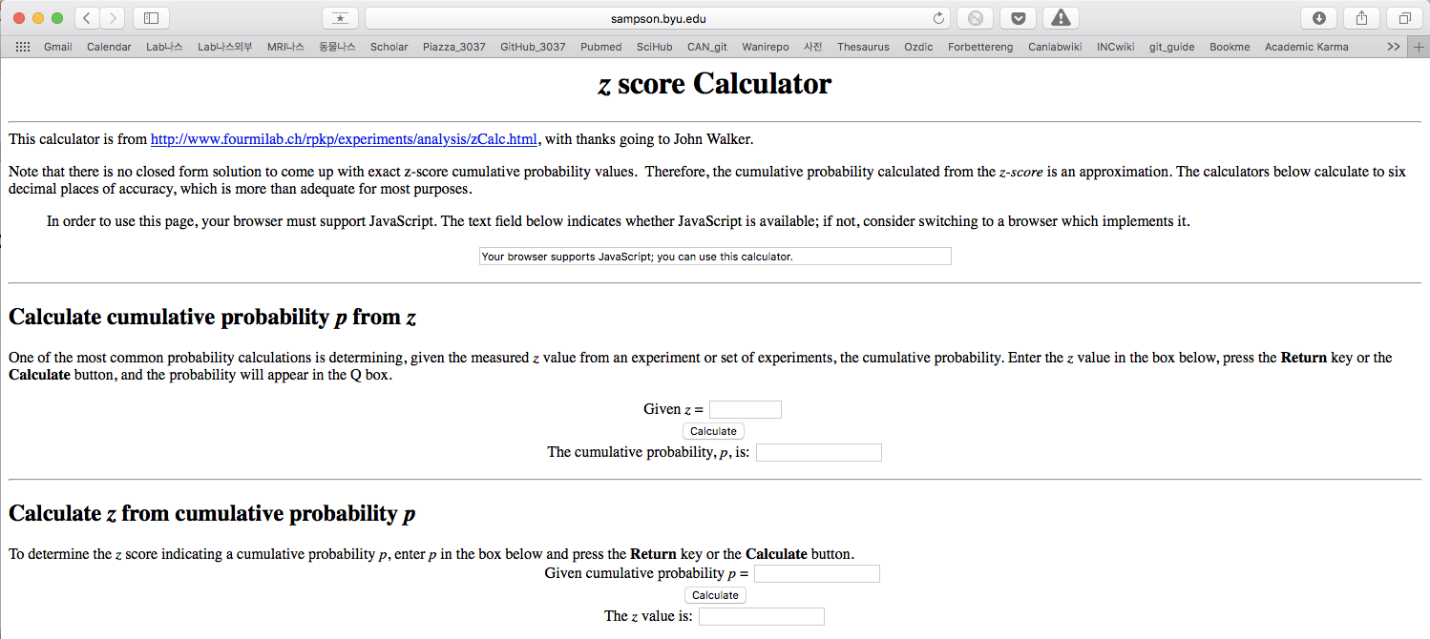
Lecture 04 | 091218
Finding Normal percentiles
http://sampson.byu.edu/courses/z2p2z-calculator.html
p-to-z is same: Table Z again.
CHOONG-WAN WOO | COCOAN lab | http://cocoanlab.github.io

Slide 18
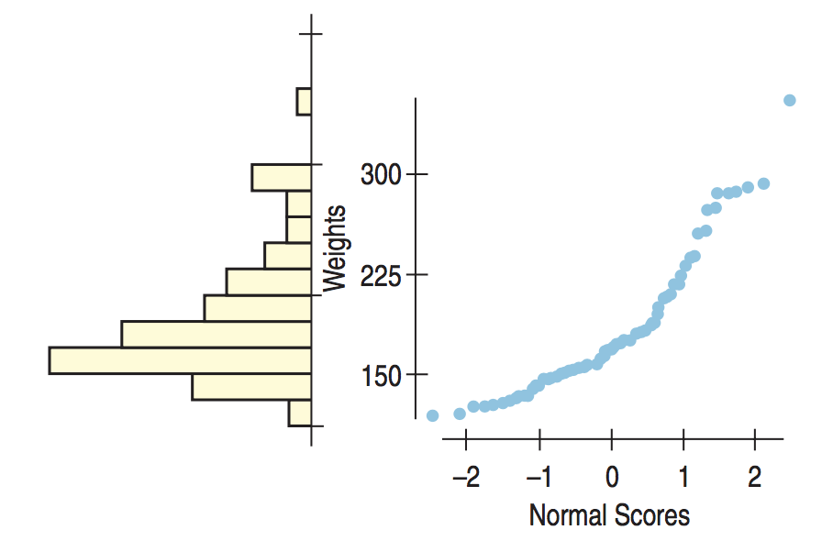
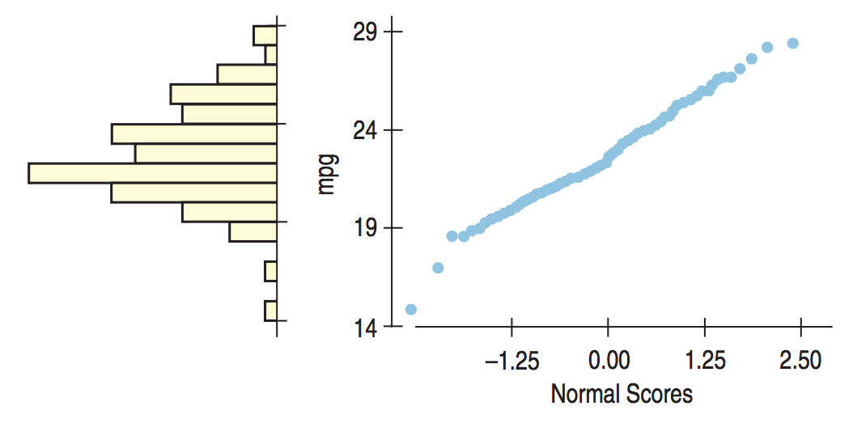
Lecture 04 | 091218
Normal probability plots
Original value against normal scores (theoretically expected value):
Similar to Q-Q plot (quantile-quantile plot)
symmetric
skewed
CHOONG-WAN WOO | COCOAN lab | http://cocoanlab.github.io

Slide 19
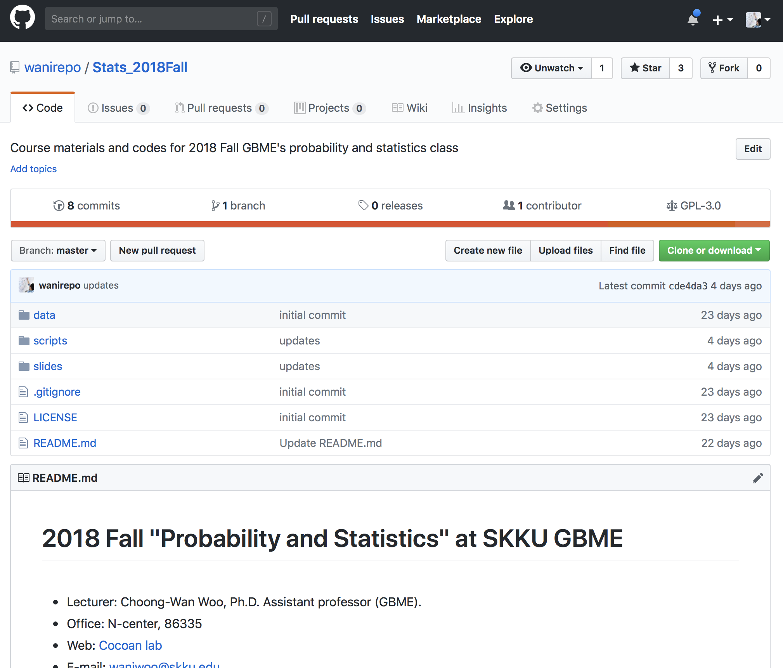
Lecture 04 | 091218
Let’s review the code:
Source code: /scripts/ L04_comparing_distributions.m
Code & output: /scripts/ L04_comparing_distributions.html
To see html, you have to download the files!
CHOONG-WAN WOO | COCOAN lab | http://cocoanlab.github.io

Slide 20
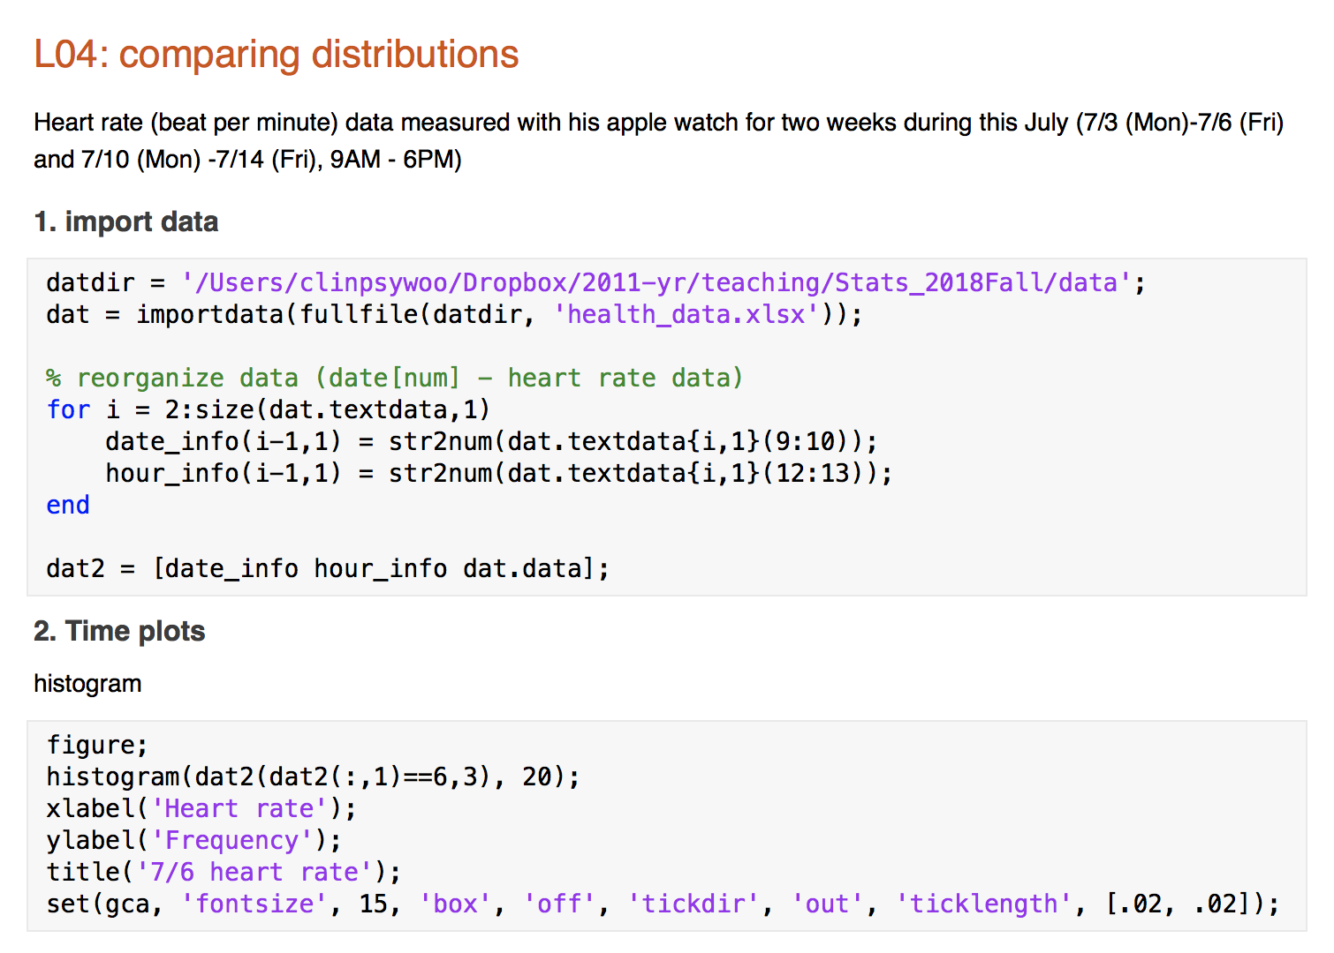
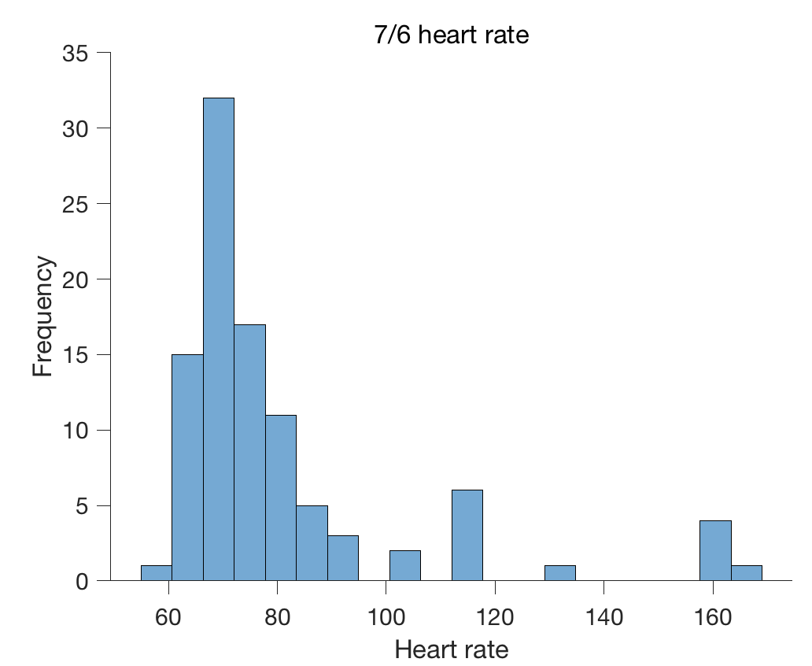
Lecture 04 | 091218
CHOONG-WAN WOO | COCOAN lab | http://cocoanlab.github.io

Slide 21
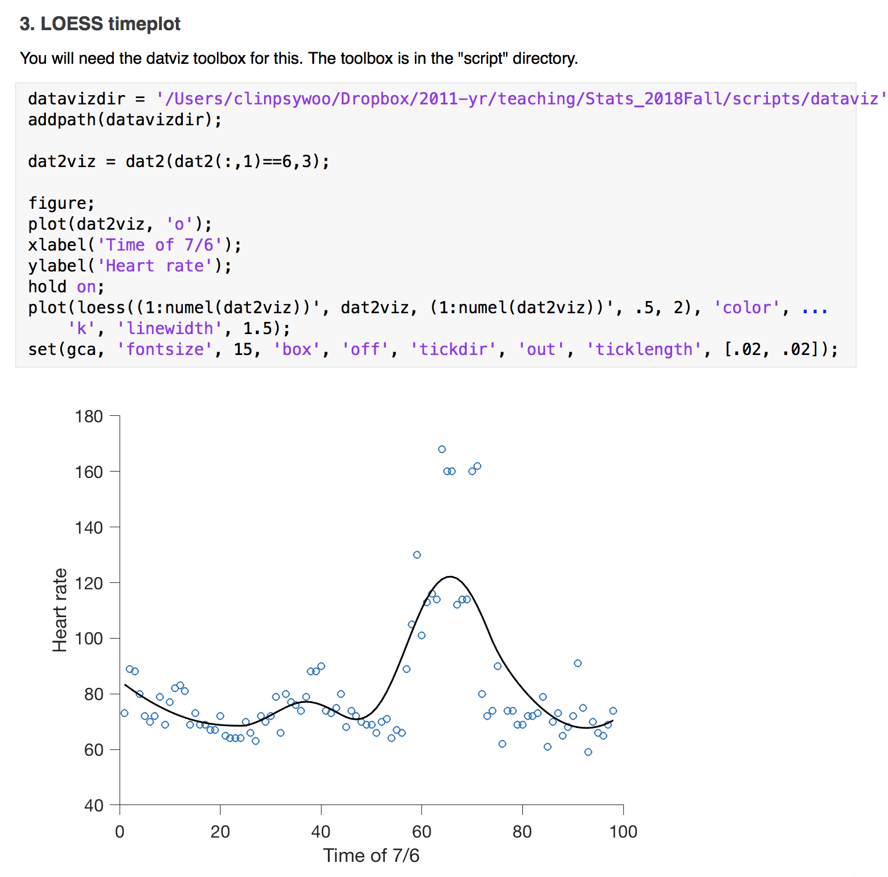
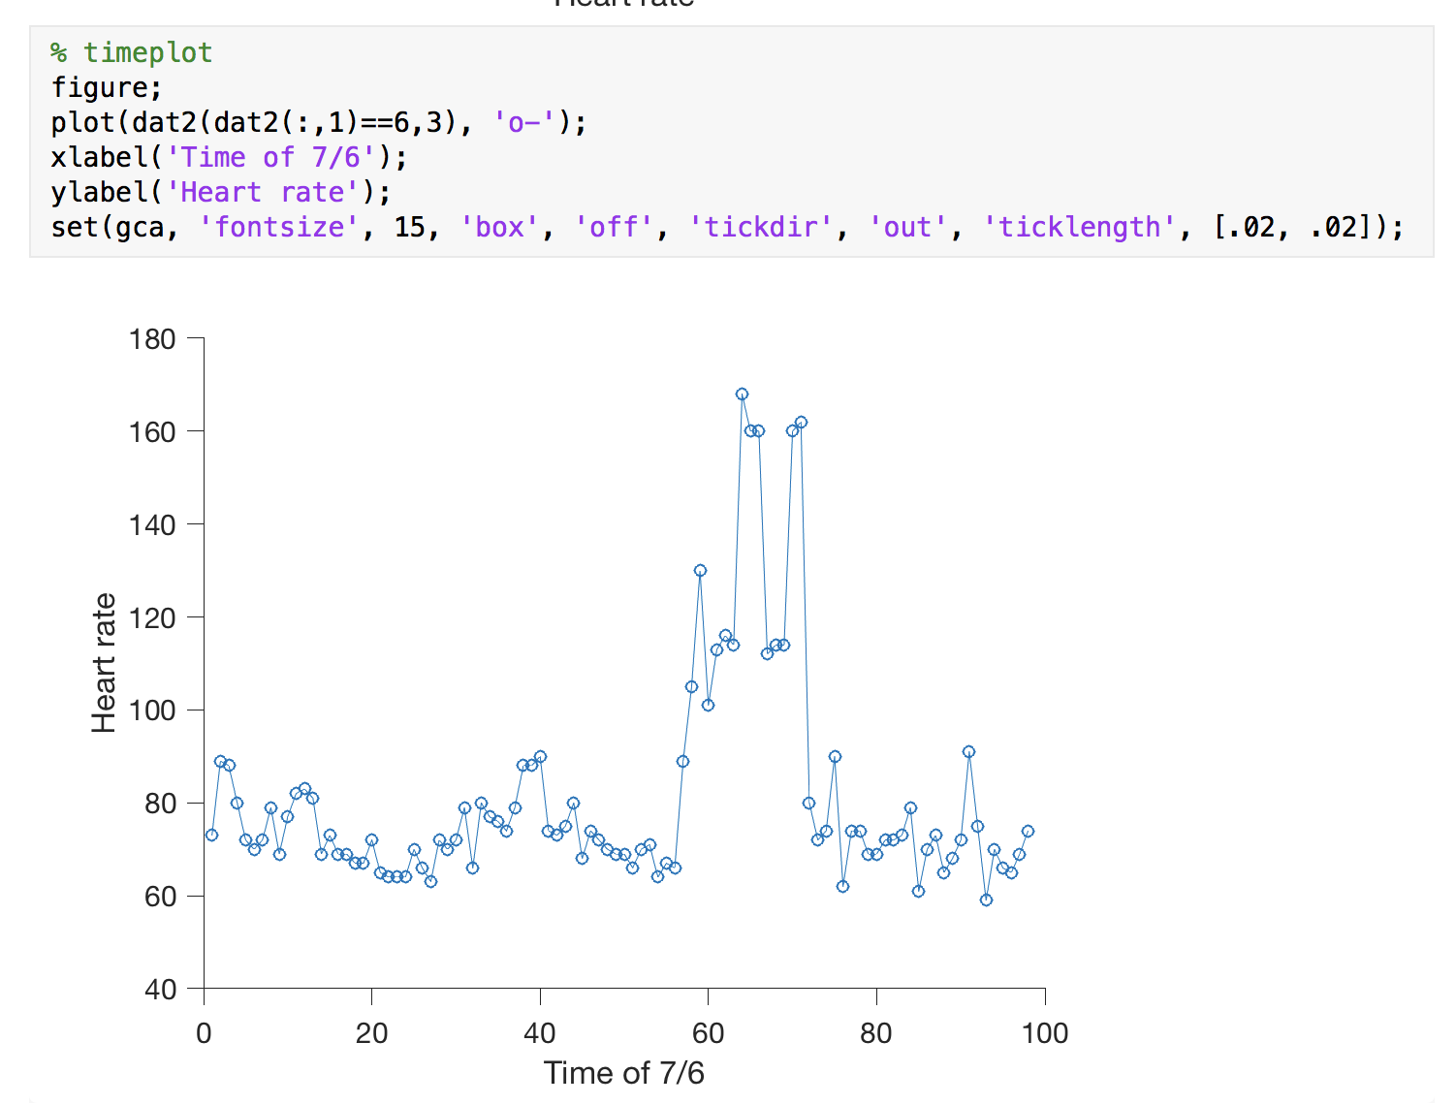
Lecture 04 | 091218
Let’s draw a timeplot and loess smoothing
CHOONG-WAN WOO | COCOAN lab | http://cocoanlab.github.io

Slide 22
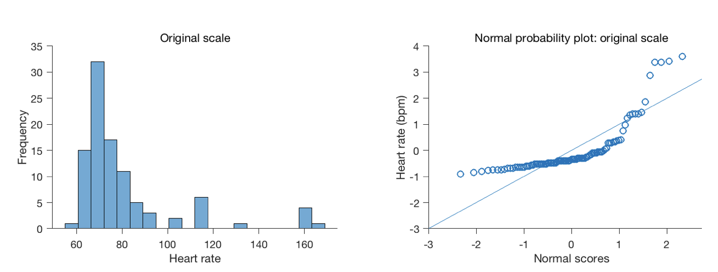
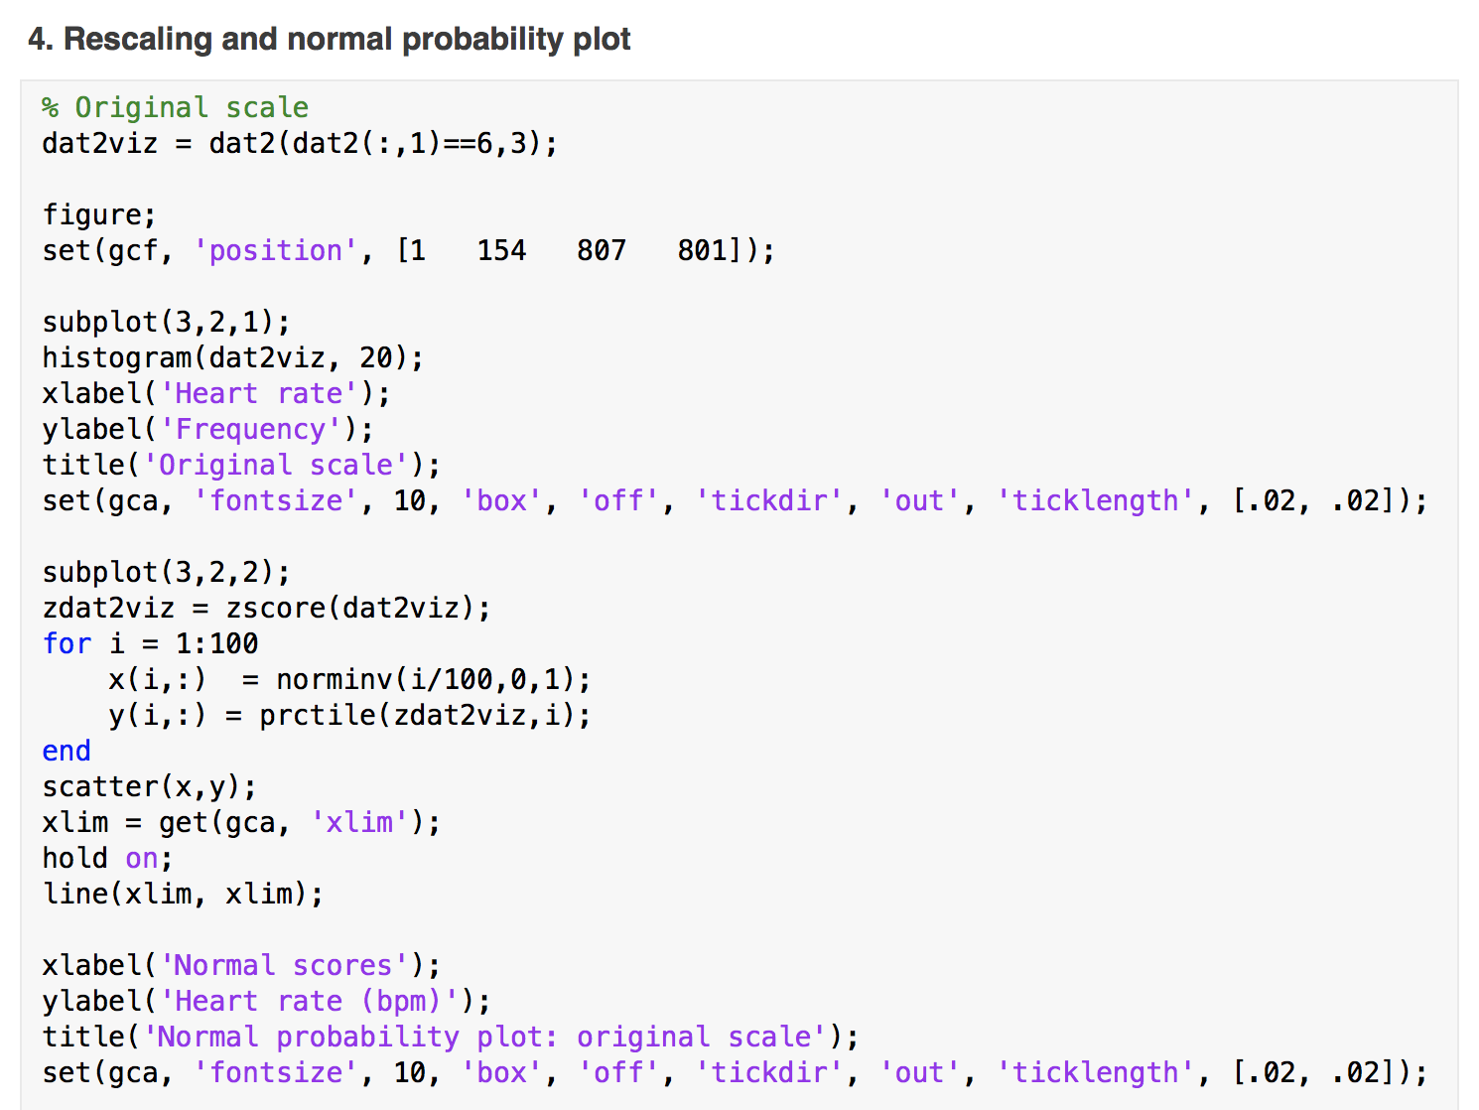
Lecture 04 | 091218
Let’s draw a normal probability plot: Original scale data
CHOONG-WAN WOO | COCOAN lab | http://cocoanlab.github.io

Slide 23
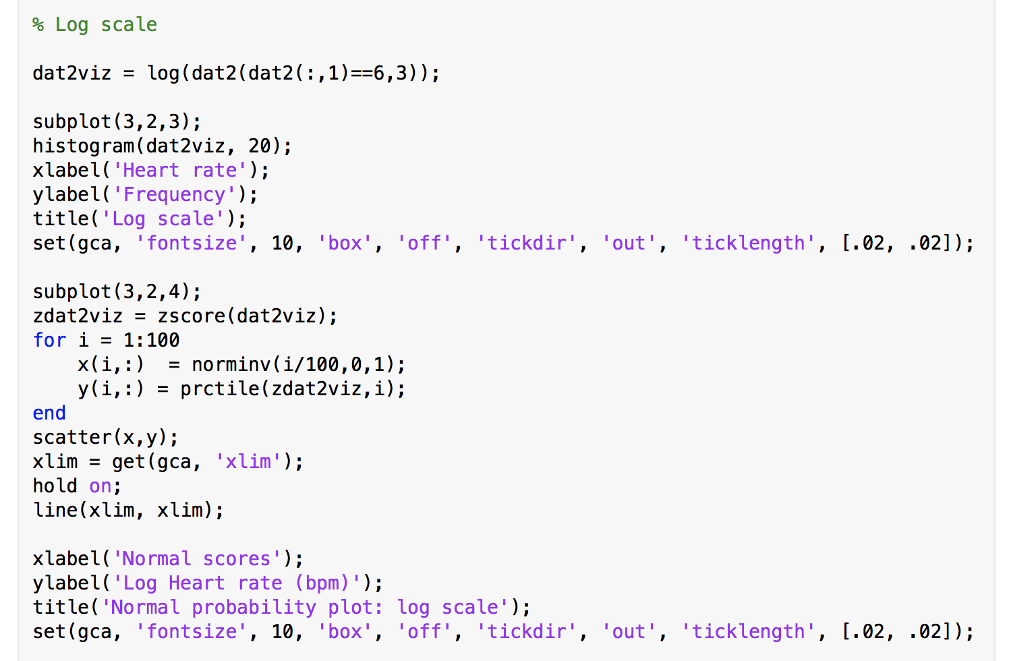
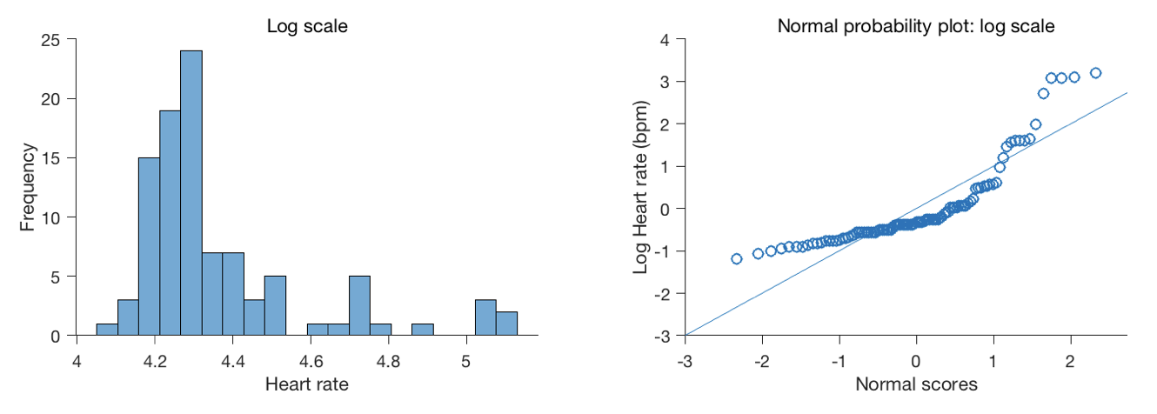
Lecture 04 | 091218
Let’s draw a normal probability plot: Log scale data
CHOONG-WAN WOO | COCOAN lab | http://cocoanlab.github.io

Slide 24
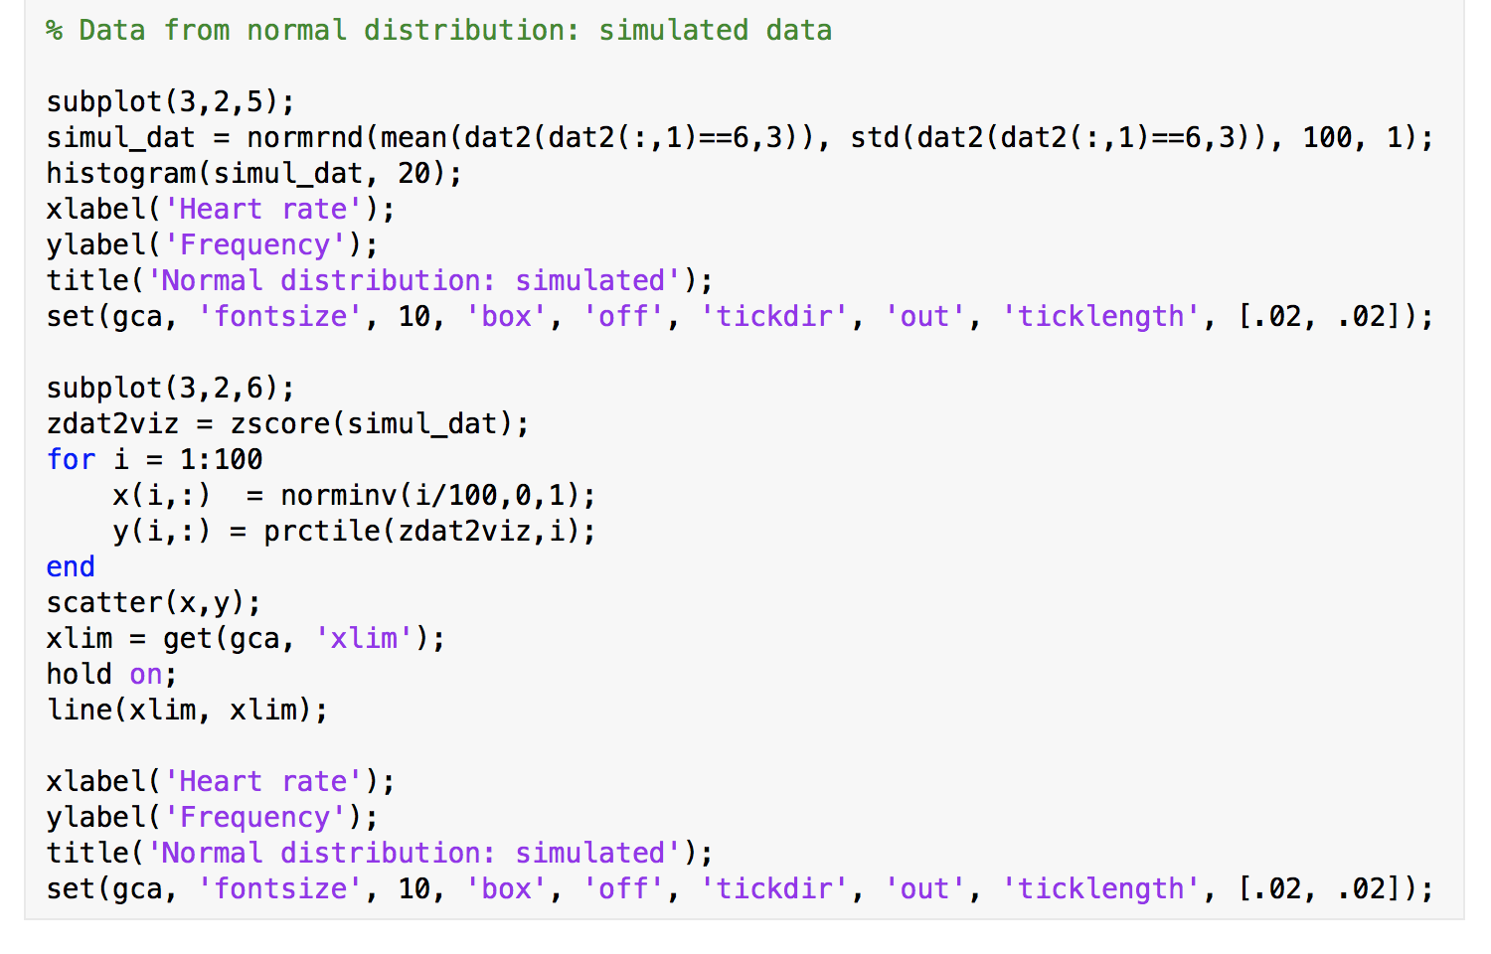
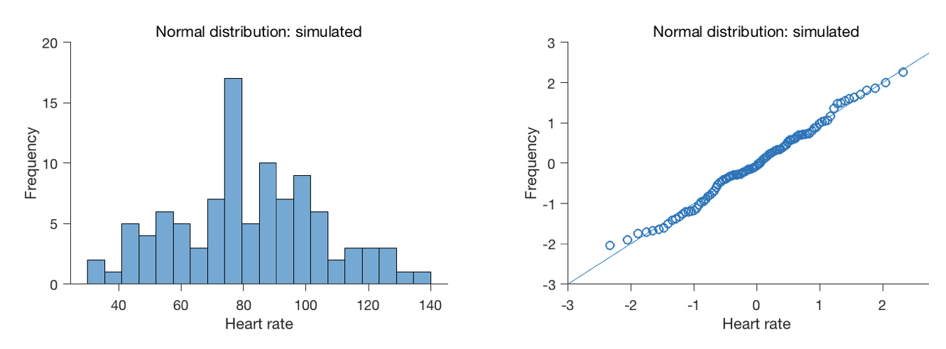
Lecture 04 | 091218
Let’s draw a normal probability plot: Normal distribution data
CHOONG-WAN WOO | COCOAN lab | http://cocoanlab.github.io

Slide 25
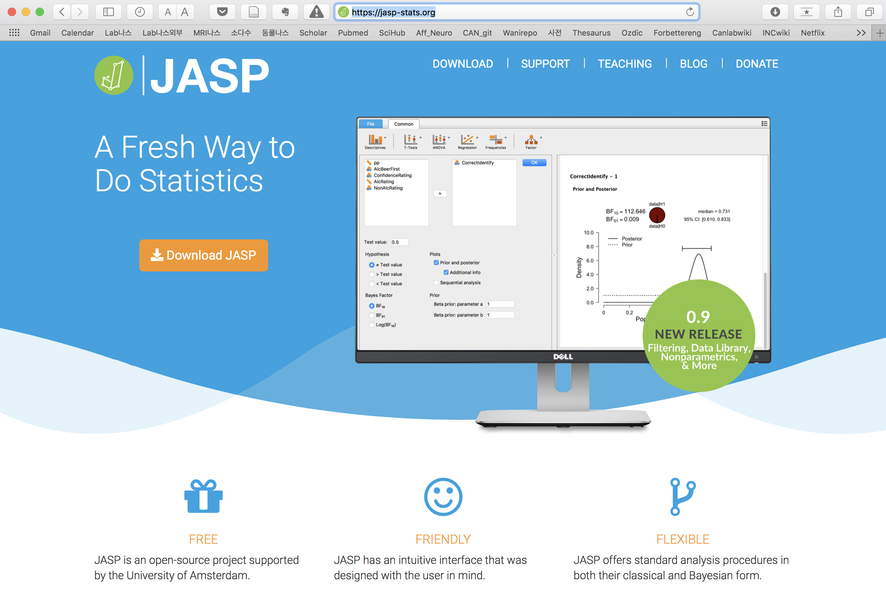
Lecture 04 | 091218
CHOONG-WAN WOO | COCOAN lab | http://cocoanlab.github.io

Slide 26
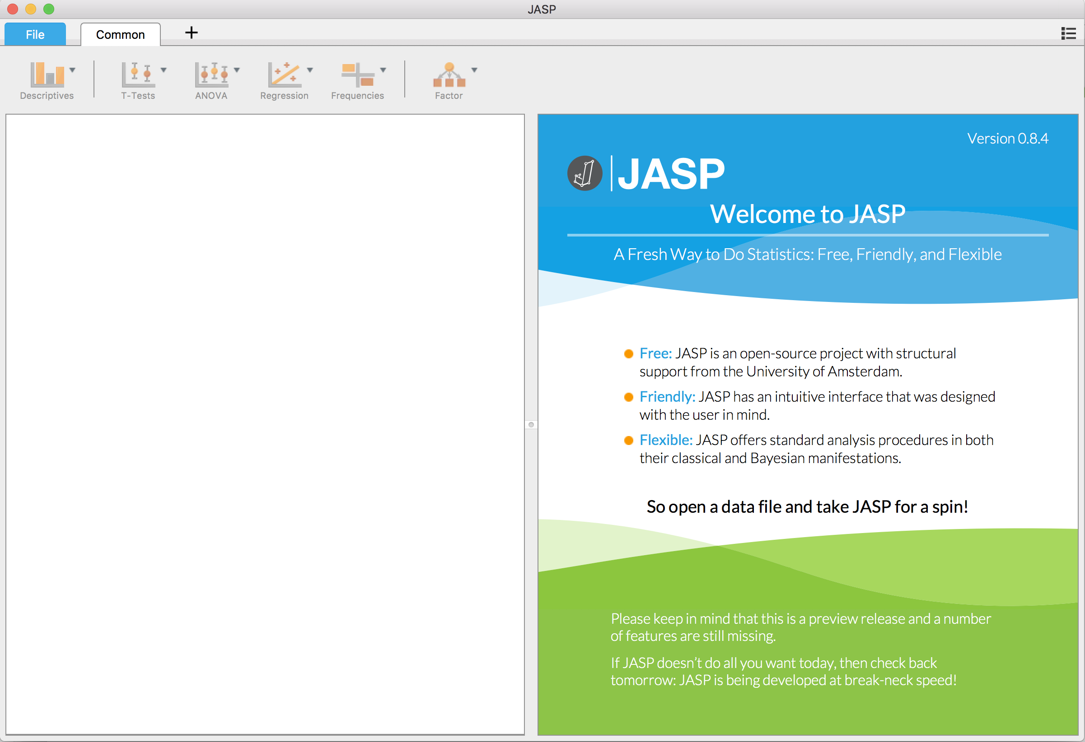
https://jasp-stats.org
Lecture 04 | 091218
Let’s try JASP next time!
CHOONG-WAN WOO | COCOAN lab | http://cocoanlab.github.io

Slide 27
Lecture 04 | 091218
Key Points
Chapter 5: Comparing distributions
Outliers are context dependent
Timeplots
Moving-averages, smoothing
Re-expressing data (log, sqrt)
to improve symmetry
to equalize spread
Chapter 6: Normal model
z-score, shifting and rescaling
Normal model,
Normality assumption; unimodal, symmetric
68-95-99.7 Rule
z-to-p, p-to-z
Normal probability plots
CHOONG-WAN WOO | COCOAN lab | http://cocoanlab.github.io

